Slide 1
Lives Changed,
Thanks to You
2020

Slide 2
You Created Pathways Out of Poverty

Slide 3
You Broke the Cycle

Slide 4
You Broke the Cycle

Slide 5
You Broke the Cycle

Slide 6
You Broke the Cycle

Slide 7
You Lifted People Out

Slide 8
You Lifted People Out

Slide 9
You Lifted People Out

Slide 10
You Provided a Safety Net

Slide 11
You Provided a Safety Net

Slide 12
You Provided a Safety Net

Slide 13
You Provided a Safety Net

Slide 14
You Provided a Safety Net

Slide 15
You Provided a Safety Net

Slide 16
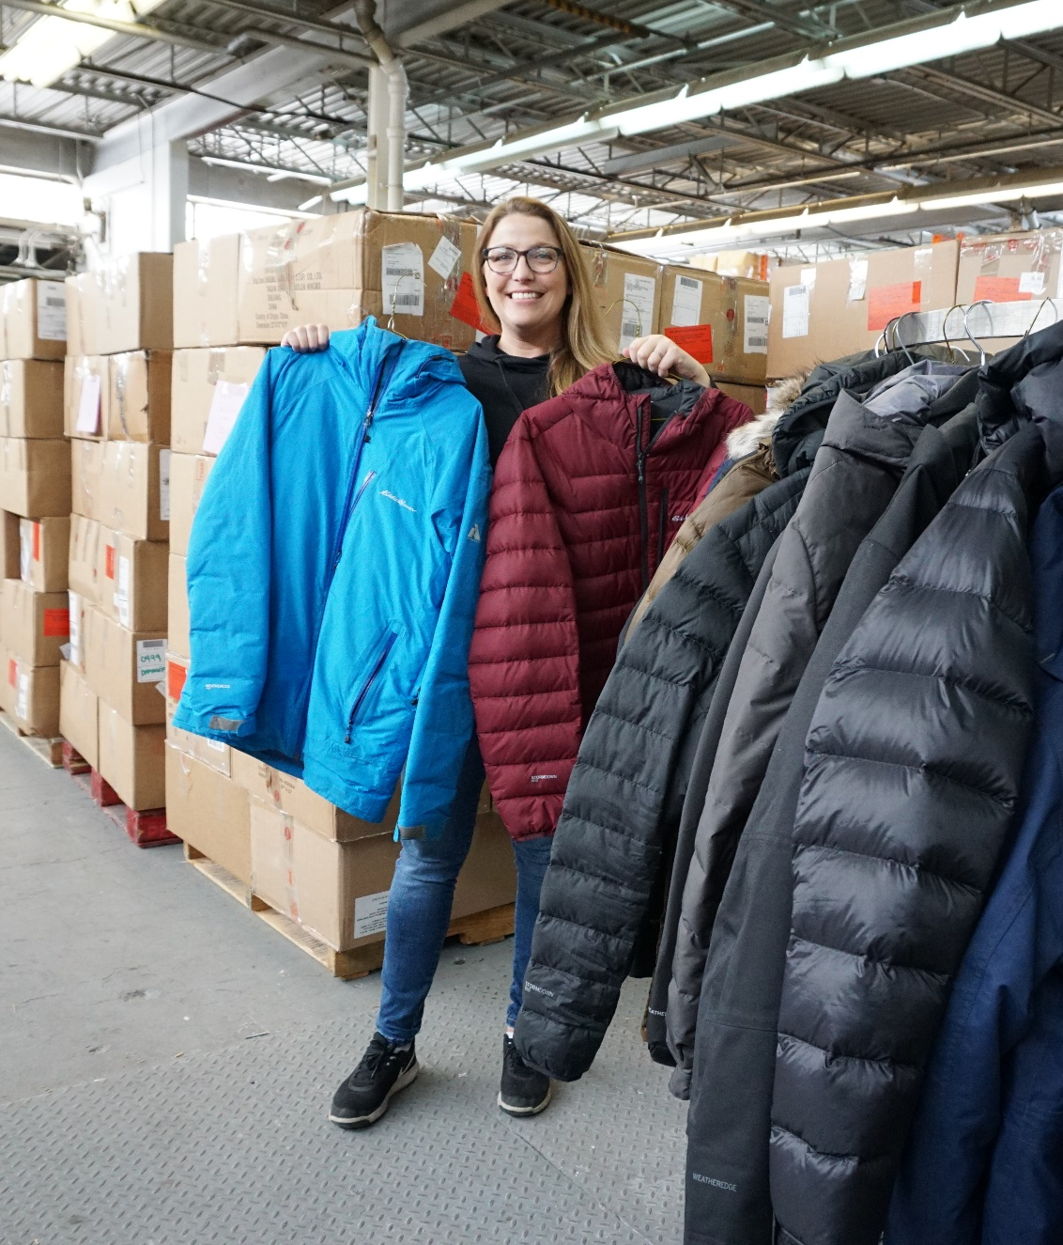
Coats for Kids and Families
5,020 individuals in need were provided with warm coats.

Slide 17
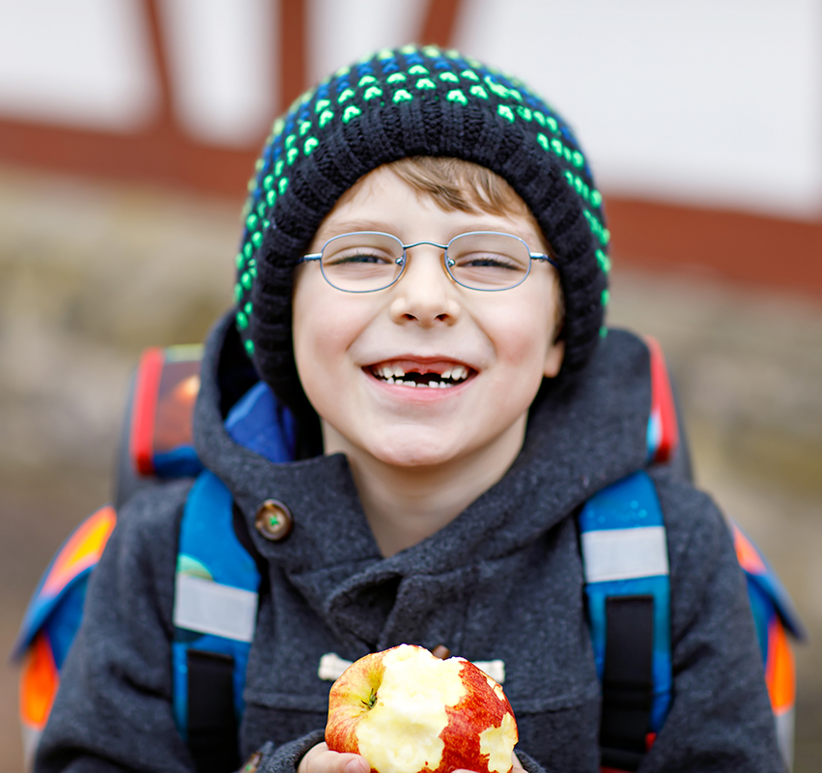
Tools for School
11,523 backpacks full of school supplies were provided to children in ​low-income families.

Slide 18
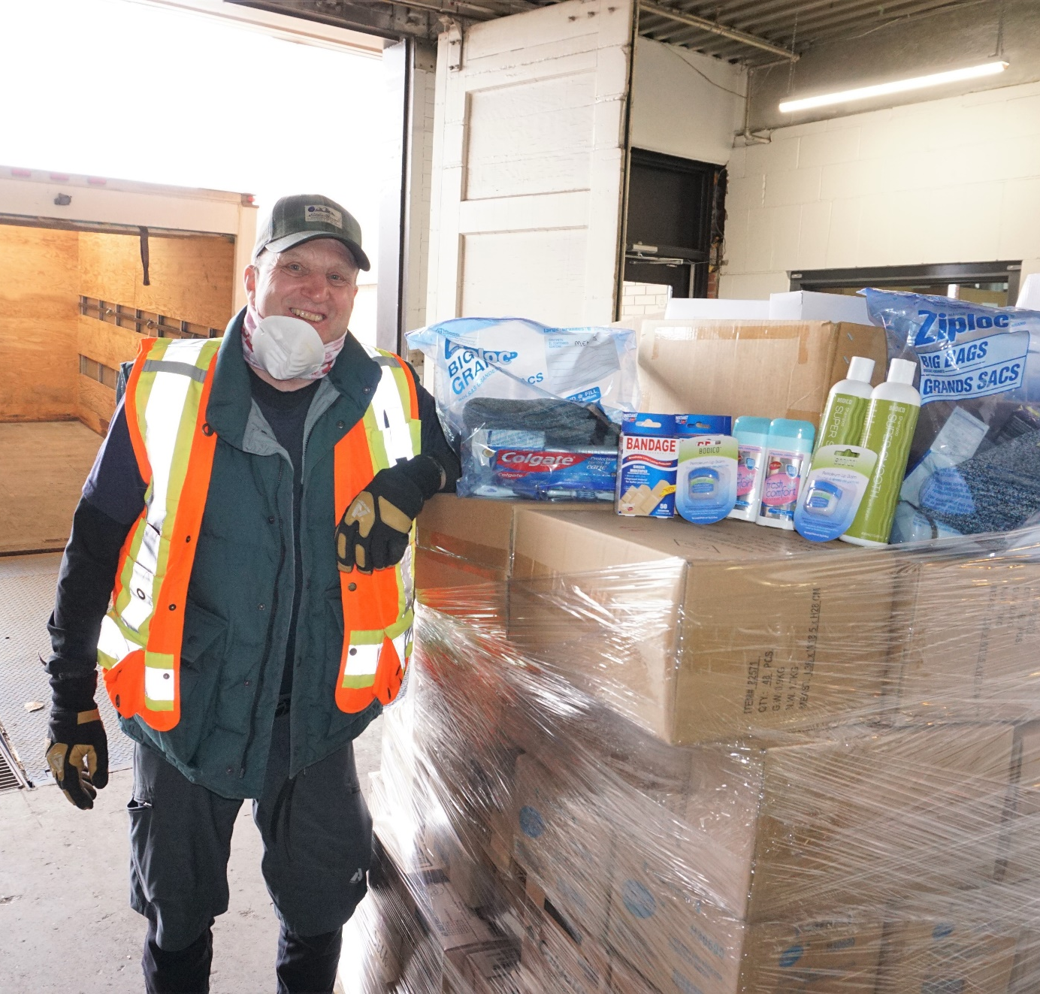
Care Kits
20,000 personal hygiene items were given to individuals without a home or living with low income.

Slide 19
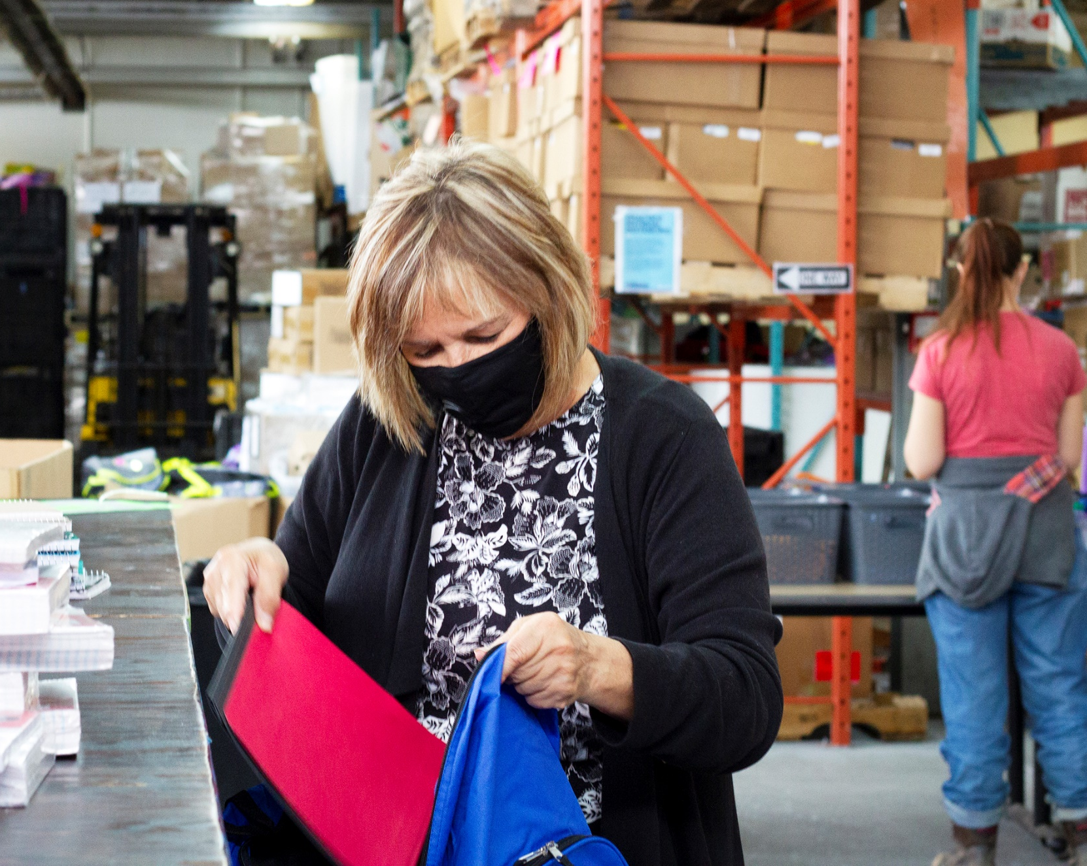
Days of Caring
51 Days of Caring were made possible by 294
volunteers.

Slide 20
Thank
You!

