Slide 1
How to Run a Successful Leaders of the Way Campaign

Slide 2
Who are Leaders of the Way Donors?
Leaders of the Way inspire others by annually contributing between $1,200 - $9,999 in support of United Way’s efforts to create pathways out of poverty in our community.
There are more than 2,000 Leaders of the Way donors in the Alberta Capital Region. Their collective investment helps address the root causes of poverty and supports long-term strategies to create lasting change.
Leaders of the Way want to understand impact and see it for themselves through volunteering and learning opportunities.

Slide 3
The Impact of Leaders of the Way Donors
Leaders of the Way make up the foundation of United Way’s annual fundraising campaign, contributing more than 25% of total giving.
Because of their passion and commitment to our community, Leaders of the Way are at the forefront in supporting critical programs and services that make an incredible difference in the lives of vulnerable neighbours.
Leaders of the Way are critical to building capacity in the social services sector. This allows non-profit agencies to focus on their frontline work serving clients in the community rather than fundraising.

Slide 4
The Impact of Leaders of the Way Donors
$1,250 can provide a brighter future for a student and their family through All in for Youth wrap-around services for one year. |  | $5,000 can provide resources to empower 50 women in a job training program. |  | $10,000 can provide wraparound psychological support for two families.

Slide 5
Tax Benefits of Being a Leader of the Way Donor
A $1,200 Leader of the Way donation translates to $650 after Provincial and Federal Tax credits!

Slide 6
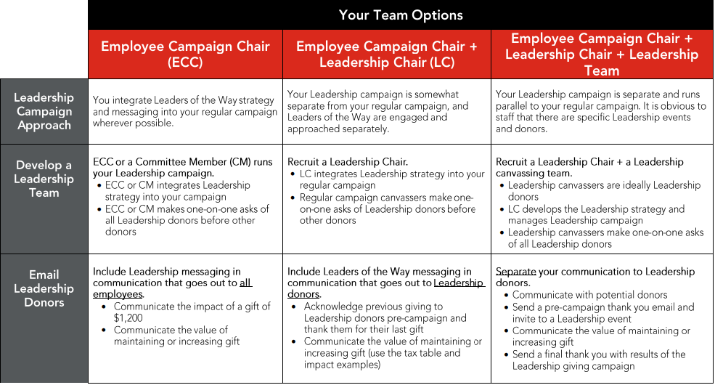
Build Your Leaders of the Way Campaign Team

Slide 7
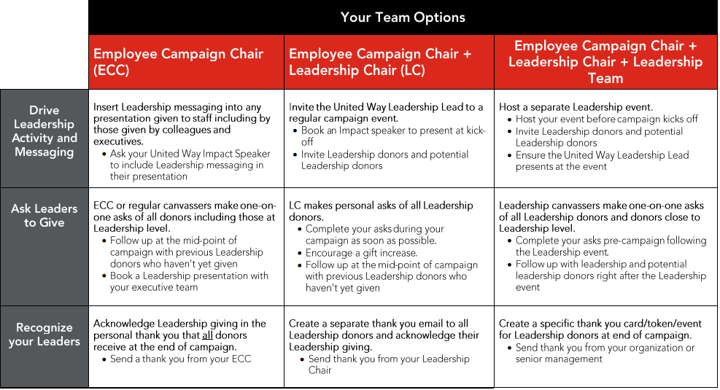
Build Your Leaders of the Way Campaign Team

Slide 8
When to Connect with your Leaders of the Way Donors

Slide 9
Engaging with Leaders of the Way Donors
United Way Community Impact Speakers
United Way will provide an Impact Speaker to talk at your Leaders of the Way event(s), or other speaking engagements, to inform and inspire audiences by sharing compelling stories about the work of United Way and our partner agencies. Speakers can be in-person or virtual using your chosen online platform (ex: Zoom, MS Teams)
Speaking Duration at Events: 10+ minutes
Community Impact Speakers are to be booked a minimum of two weeks in advance of your event through your United Way Portfolio Lead.

Slide 10
Engaging with Leaders of the Way Donors
Days of Caring – Volunteer Opportunities
Days of Caring volunteer opportunities are a great way for Leaders of the Way donors to get involved in our community and offers the chance to actively support United Way programs and our local funded agencies.
Days of Caring Volunteer Opportunities are booked through your Portfolio Lead.

Slide 11
Engaging with Leaders of the Way Donors
Agency Tours
United Way can host an agency tour where Leaders of the Way may sign up together to gain valuable insight into the history and current happenings of select local funded agencies. An agency tour provides attendees with a unique perspective of how donors are making an impact in our community.
Agency Tours can be booked by your Portfolio Lead.

Slide 12
Engaging with Leaders of the Way Donors
Leaders of the Way Assets:
Inspiration Video (pre-campaign digital asset):
A video will be sent to Leaders of the Way donors via United Way's @ Work Welcome Email to thank them for their past support and to inspire them to give again. This video can also be played at Leaders of the Way events.
Leaders of the Way Email Signature Graphic (digital asset):
The Leaders of the Way graphic that can be downloaded and added to the donor’s current email signature. This optional graphic demonstrates to their co-workers and their external network that they are a Leader of the Way donor with United Way of the Alberta Capital Region.
Leaders of the Way Pins (material asset):
Leaders of the Way may receive a branded pin that they can wear on their clothing to show that they are a Leader of the Way donor with United Way of the Alberta Capital Region.

Slide 13
For more information about Leaders of the Way, please contact:
Darren Brennan
Relationship Manager, Major & Leadership Gifts
United Way of the Alberta Capital Region Direct: 780-443-8373
dbrennan@myunitedway.ca
Learn more at www.myunitedway.ca/leaders/

